Slide 1
Understanding Web Archiving Services
and Their (Mis)Use on Social Media
CS 895: Web Archive Forensics
Fall 2022
Authors: Savvas Zannettou, Jeremy Blackburnz, Emiliano De Cristofaroy, Michael Sirivianos, Gianluca Stringhini
Published: The 12th International AAAI Conference on Web and Social Media, 2018
Presented by
Tarannum Zaki
@tarannum_zaki @WebSciDL
Date: 26 September, 2022
Notes:
‹#›

Slide 2

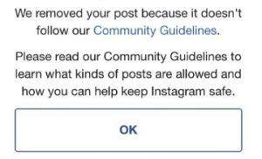
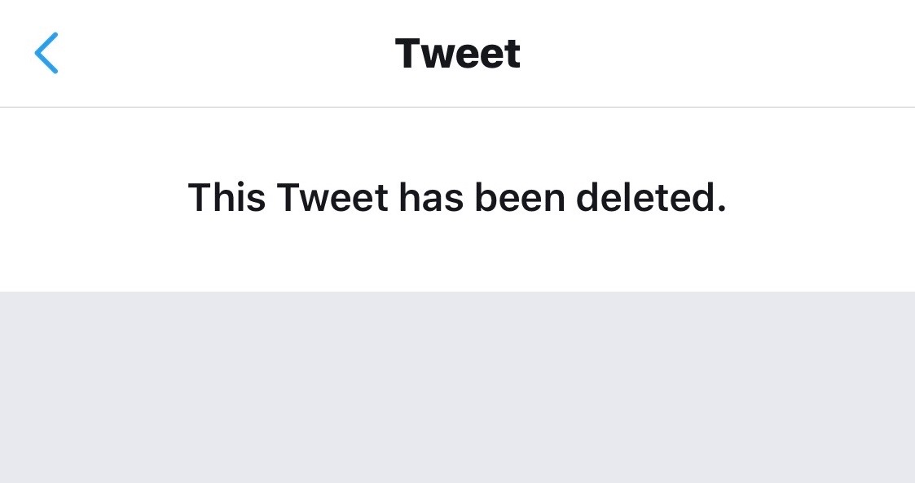
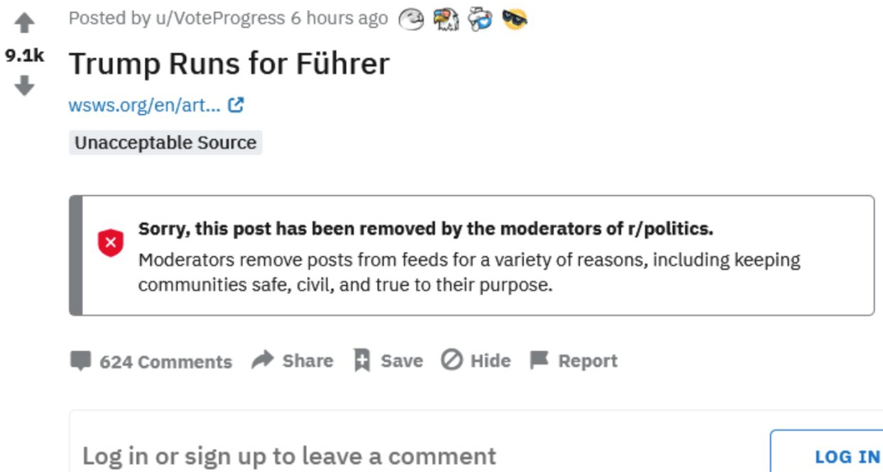
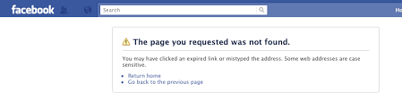
Deleted!
Not Found!
Unavailable!
Inaccessible!
Removed!
Does Not Exist!
https://www.techgogoal.com/wp-content/uploads/2020/05/PicsArt_05-03 10.02.14_compress68.jpg
https://dispensarymktg.com/wp-content/uploads/2019/01/removed-instagram-post-300x182.png
https://pbs.twimg.com/media/EeJY-SdUYAI6ecj.jpg
https://www.wsws.org/asset/ece2ca26-3a8f-431e-8b2c-a7f4af95fbd2?rendition=image1280
2
https://i.ibb.co/t8bMHyh/RFmvn.png

Slide 3
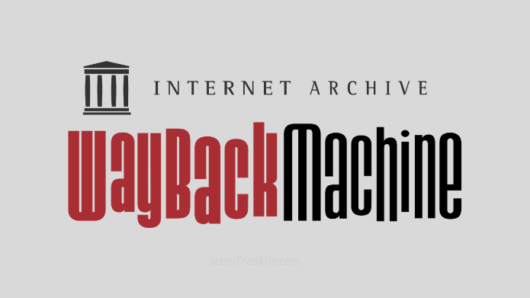
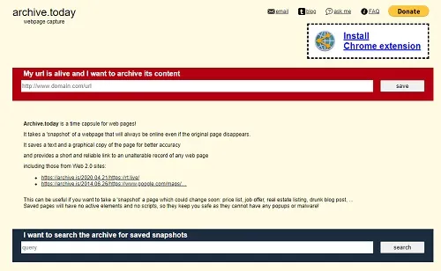

Solution?
Web Archiving Services
https://i0.wp.com/www.jasonfranklin.com/wp-content/uploads/2019/09/Wayback-Machine-Internet-Archive.png
https://i0.wp.com/cynmackley.com/wp-content/uploads/2020/07/archive-today.jpg
https://support.archive-it.org/hc/article_attachments/360049422931/Archive-It_black_raster_logo.png
3

Slide 4
Research Motivation
Could information be weaponized in different contexts due to any sort of misuse of the services provided by Web Archives?
4

Slide 5
Research Objectives
To perform a large-scale quantitative analysis of
Web Archives.
To explore the use of Web Archiving services on social media.
To investigate the actors involved in this ecosystem.
To find out what content is archived and how it is shared on social media.
5

Slide 6
Research Questions
[RQ1] How are archive URLs disseminated across popular social networks?
[RQ2] What kind of content gets archived, by whom and why?
[RQ3] Are archiving services misused in anyway?
6

Slide 7
Web Archiving Services
Wayback Machine
proactively archiving since 2001.
archives large number of webpages.
archive.today or archive.is
relatively a newer service.
create on-demand snapshots of specific webpages.
7

Slide 8
Social Networks
Twitter
a micro-blogging social network.
posts short remarks known as ‘tweets’
retweets help to share content.
Reddit
a social news aggregator site.
user forums are known as ‘subreddits’.
up/down votes help to share content.
8

Slide 9
Social Networks
4chan
an imageboard discussion forum.
accounts are anonymous and ‘flag’ attribute provides country-based identity.
active threads help to share content.
Gab
hybrid of Twitter and Reddit.
launched in 2016.
posts short remarks knows a s ‘gabs’ and voting helps content sharing.
9

Slide 10
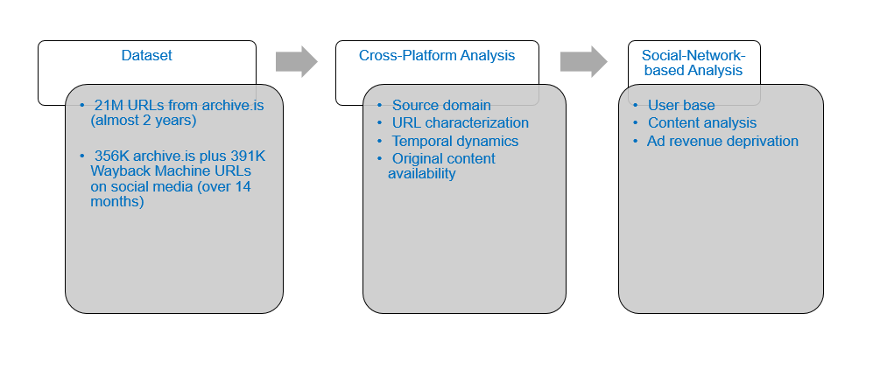
Methodology
10

Slide 11
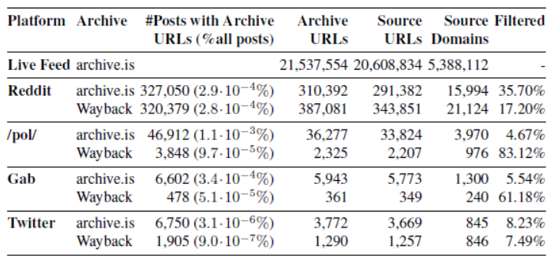
Dataset
Table 1: Overview of our datasets: number and percentage of posts that include archive URLs, unique number of archive URLs, source URLs, and source domains. We also filter URLs that are malformed, unreachable, or point to resources other than Web pages.
11

Slide 12
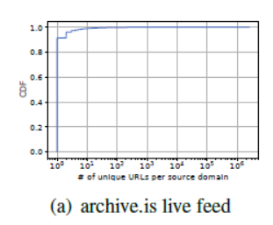
Cross-Platform Analysis : Source Domains
Live Feed
90% of domains only appear once
1.2M distinct archive.is URLs belong to Twitter.com
Figure 1(a): CDF of the number of distinct URLs per source domain for archive.is’s live feed.
12

Slide 13
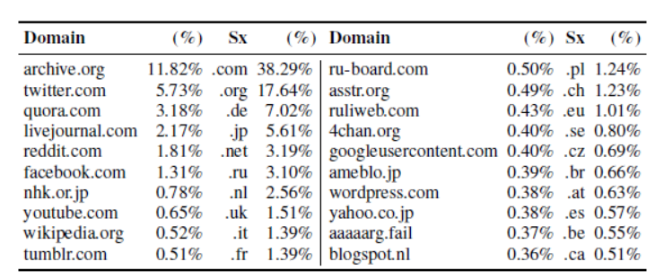
Cross-Platform Analysis : Source Domains
Live Feed
11.8% is the Wayback Machine’s archive.org
common suffixes .com and .org
major user base of archive.is might belong to Japan and Germany
Table 2: Top 20 domains and suffixes of the source URLs in the archive.is live feed dataset.
13

Slide 14
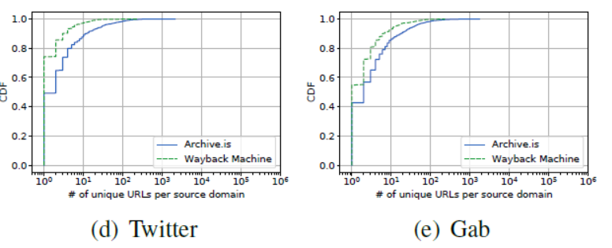
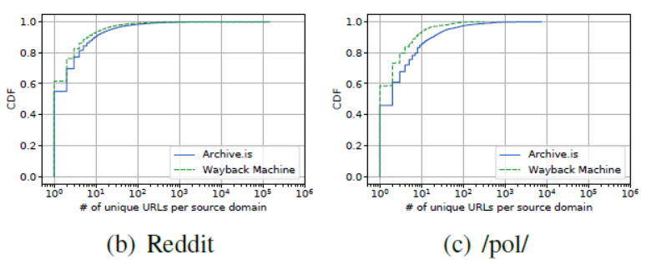
Cross-Platform Analysis : Source Domains
Social Networks
over 40% of the source domains only appear once.
Wayback Machine generally archives more than archive.is
Figure 1(a)-(e): CDF of the number of distinct URLs per source domain for social networks.
14

Slide 15
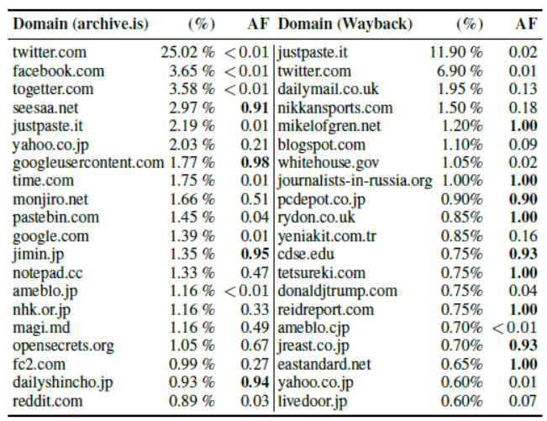
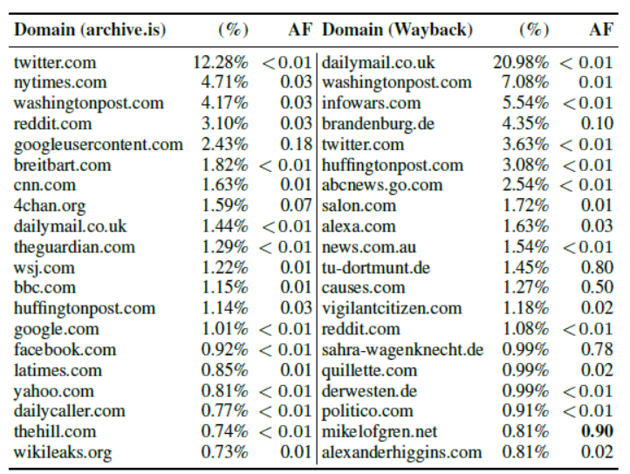
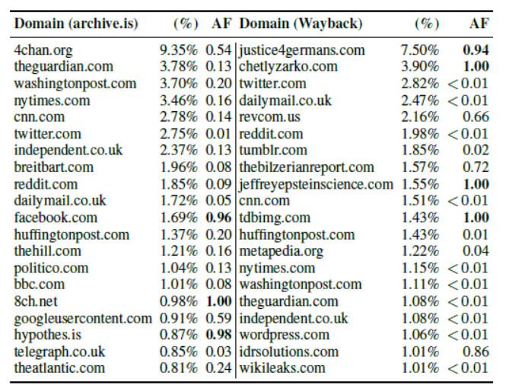
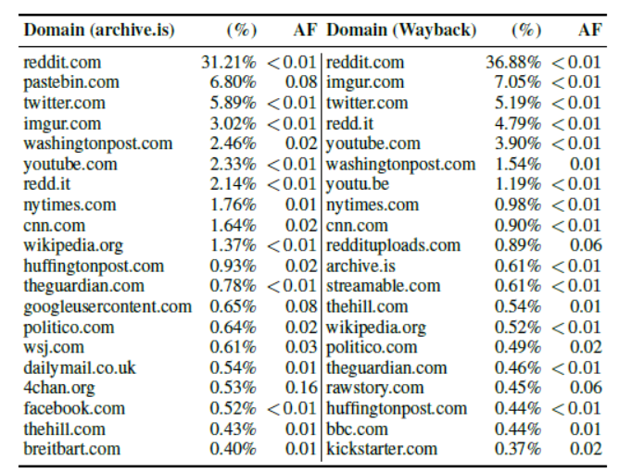
Cross-Platform Analysis : Source Domains
Social Networks
except Gab the most popular domain archived is the platform itself
mainstream news sources are archived and shared on Reddit, /pol/, and Gab
on 4chan (/pol/), specific domains have extremely high archival fractions (AFs)
15
Table 3-6: Top 20 source domains of archive.is and Wayback Machine URLs, and archival fraction (AF) - Reddit, 4chan (/pol/), Twitter, and Gab respectively.
Notes:
archival fraction (AF) - the number of times a source domain appears in an archive over the total number of times it appears in the dataset (either archived or not).

Slide 16
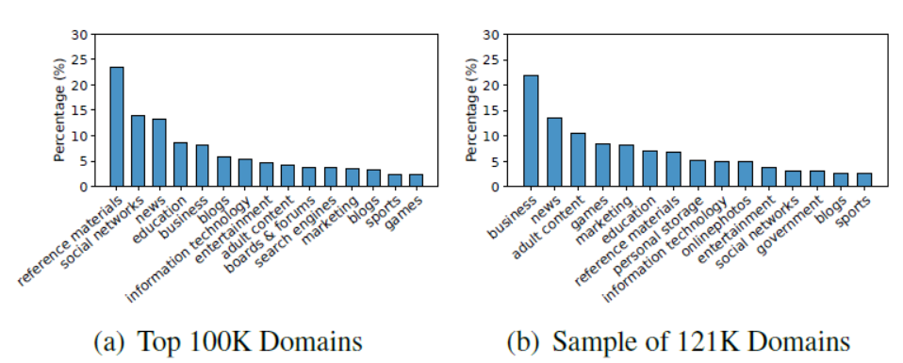
Cross-Platform Analysis : URL Characterization
Live Feed
the most popular category is Reference Materials
other popular categories include Social Networks, News Sources, Education and Business
for empirically distributed sample, the top categories are Business, News, and Adult Content
Figure 2: Top 15 domain categories for the archive.is live feed.
16

Slide 17
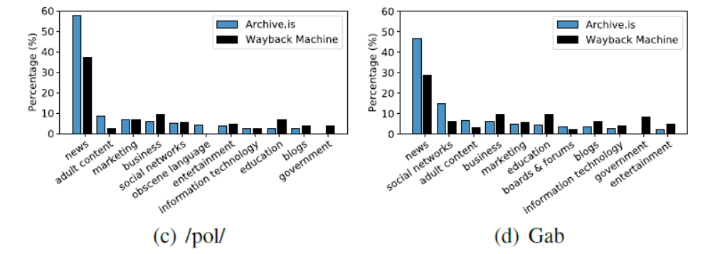
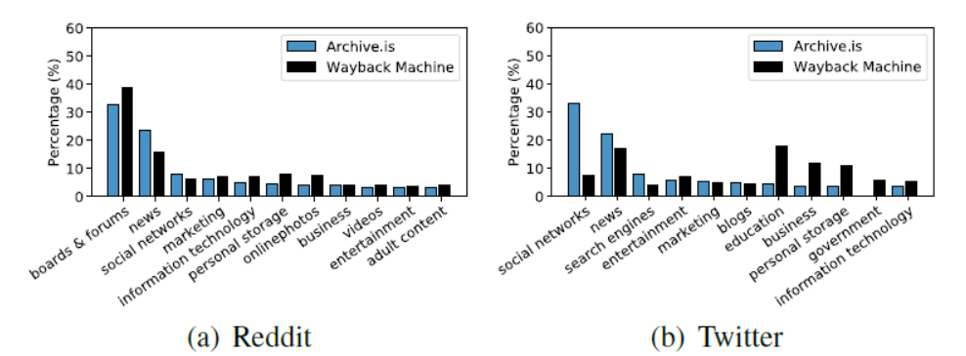
Cross-Platform Analysis : URL Characterization
Social Networks
both archiving services share URLs from news sources, social networks, and marketing sites on all social networks
Education and Government URLs appear as top categories for the Wayback Machine
‘questionable’ content appear only for archive.is
Figure 3: Top domain categories for archive URLs appearing on the four social networks.
17

Slide 18
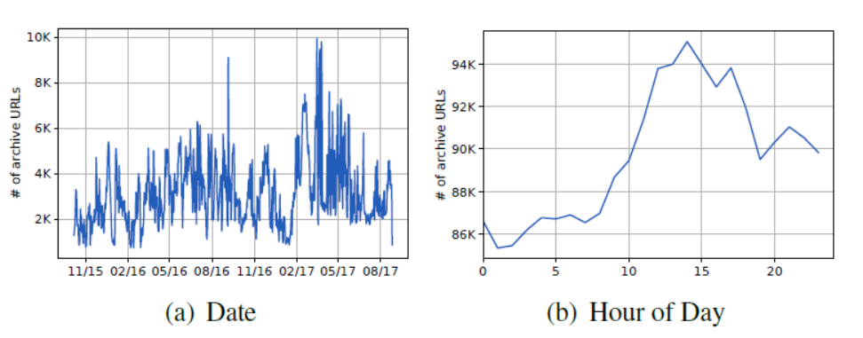
Cross-Platform Analysis : Temporal Dynamics
Live Feed
each day, between 1K and 10K URLs are archived (mostly between 11AM and 4PM UTC time, with a peak at 2PM)
a great number of users may be located in Europe and the US
Figure 4: Temporal analysis of the archive.is live feed dataset, reporting the number of URLs that are archived (a) each day and (b) based on hour of day.
18

Slide 19
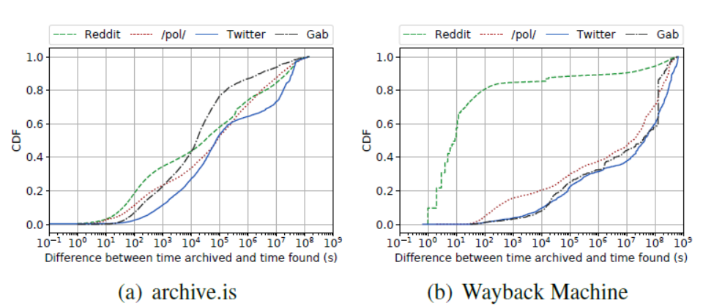
Cross-Platform Analysis : Temporal Dynamics
Social Networks
interval between archiving and sharing of a URL ranges for a few seconds
Reddit is the ‘fastest’ platform for Wayback Machine URLs
Gab is the ‘fastest’ platform for archive.is
Figure 5: CDF of the time difference between the archival time and the time appeared on each of the four social networks.
19
Notes:
slack time is the time difference between the archival time on archiving services and the appearance on other social media.

Slide 20
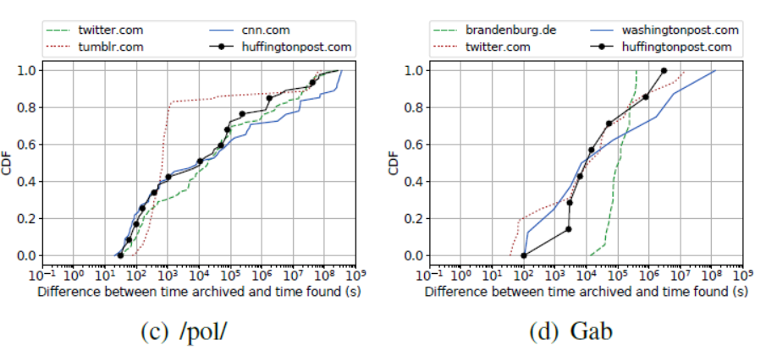
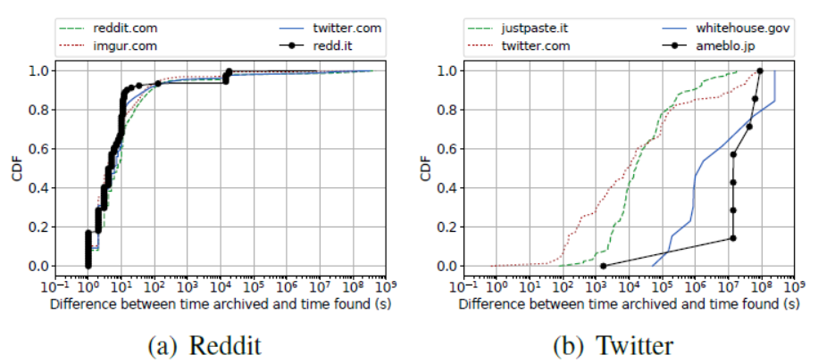
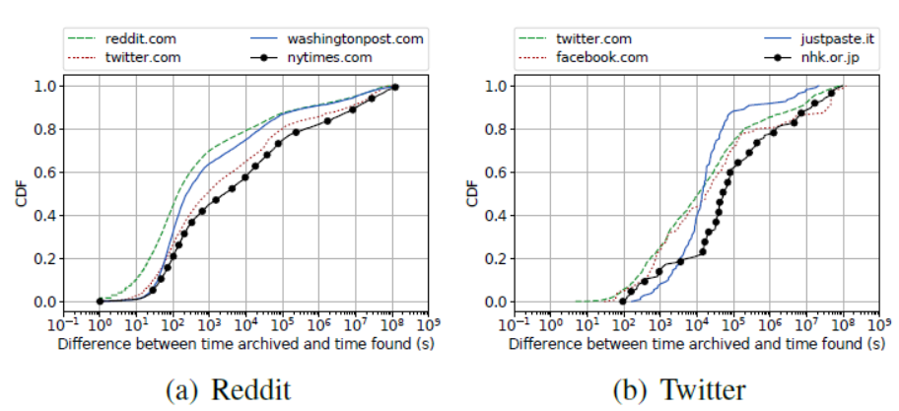
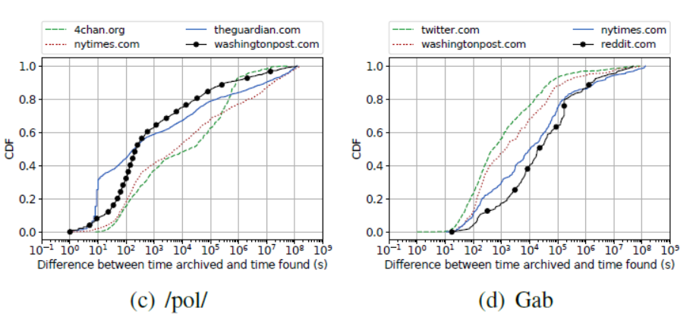
Cross-Platform Analysis : Temporal Dynamics
Social Networks
Reddit and Twitter itself is the fastest domain for both archives
URLs pointing to 4chan are slower
On Gab, Twitter is fastest, Reddit is slower
Figure 6-7: CDF of the time difference between archival time on archive.is and Wayback Machine (respectively) and appearance on social networks for the top four source domains.
20

Slide 21
Cross-Platform Analysis : Original Content Availability
Live Feed
12% of the source URLs corresponding to archive URLs on archive.is live feed are not available anymore
Domains with most unavailable content are: twitter.com (6%), nhk.or.jp (6%), googleusercontent.com (3%), aaaaarg.fail (3%), and 4chan.org (3%).
Social Networks
For Reddit, source URLs corresponding to both archive.is and Wayback Machine are still available (93% and 89% of them, respectively)
For 4chan (/pol/), it is 82% and 66%
For Gab it is 87% and 48%
For Twitter, it is 76% and 49%
21

Slide 22
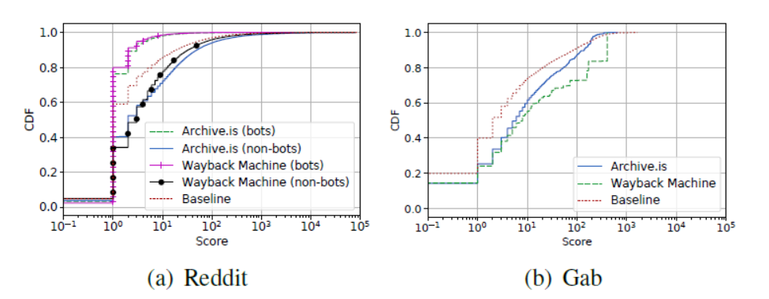
Social-Network-based Analysis : User Base
Social Networks - Reddit and Gab
31% of all archive.is URLs and 82% of Wayback Machine URLs in Reddit are posted by a specific bot
Posts with Wayback Machine URLs have higher scores than those with archive.is URLs, and the baseline
Figure 8: CDF of the scores of posts that include archive.is and Wayback Machine URLs.
22

Slide 23
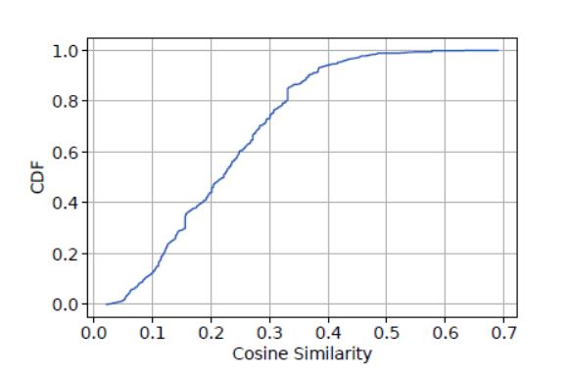
Social-Network-based Analysis : Content Analysis
Content similarity using Latent Dirichlet Allocation (LDA) - Reddit and 4chan
80% of the terms have similarity under 0.3
Preserve content relevant to controversial stories and conspiracy theories
Figure 9: CDF of cosine similarity of words obtained from LDA topics on Reddit and /pol/ threads.
23

Slide 24
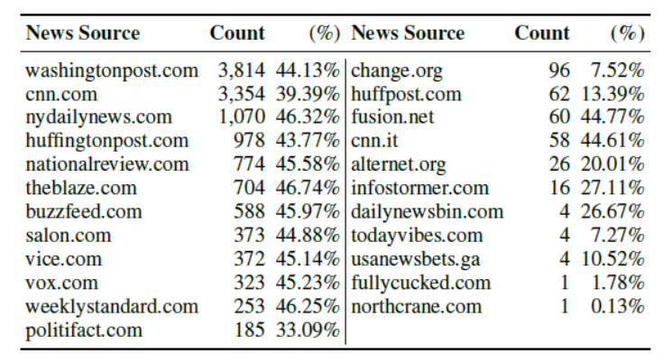
Social-Network-based Analysis : Ad Revenue Deprivation
“Your submission was removed because it is from cnn.com, which has been identified as a severely anti-Trump domain. Please submit a cached link or screenshot when submitting content from this domain. We recommend using www.archive.is for this purpose.”
Table 8: Number and percentage of submissions deleted from The Donald with links to different news sources.
24

Slide 25
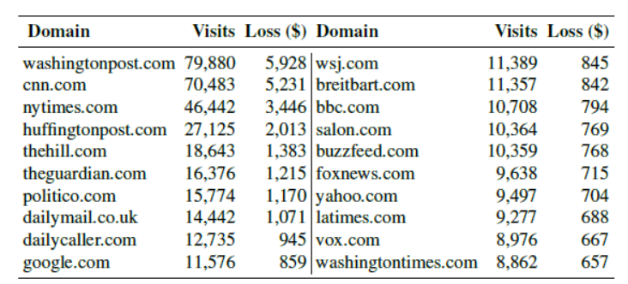
Social-Network-based Analysis : Ad Revenue Deprivation
Conservative estimate of ad revenue deprivation is around $70K per year for the Washington Post alone.
Table 9: Top 20 domains with the largest ad revenue losses because of the use of archiving services on Reddit. We report an estimate of the average monthly visits from Reddit and the monthly ad loss.
25

Slide 26
Main Findings
News and social media posts are common content that are archived.
Archived URLs are extensively shared on ‘fringe’ communities within Reddit and 4chan.
4chan and Gab users prefer archive.is over Wayback Machine.
Web archives are misused by social media users where platform-specific-censorship persists.
Reddit moderator bots are mostly responsible for posting archived URLs in the subreddits.
Moderation bots manipulate users to post archived URLs by blocking certain URLs and targets ad revenue of news resources.
26

Slide 27
Conclusion
Web archives serves a crucial role in persisting web content.
Misuse of web archiving services result in potentially taking away thousands of dollars in ad revenue.
Ethical implications regarding the use of web archiving services are required.
27

